Slide 1
Data Analytics - Airmech case study
- Su YANG

Slide 2
Goals
Collect monetization and in-game behavior data.
Predict the likelihood a player is going to leave the game, understand why, take decisions and actions accordingly.

Slide 3
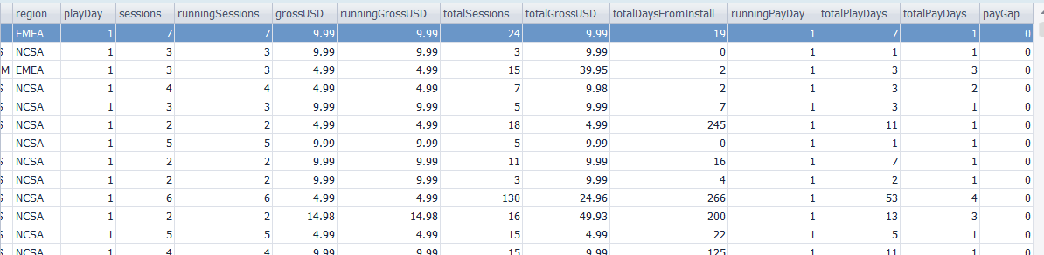
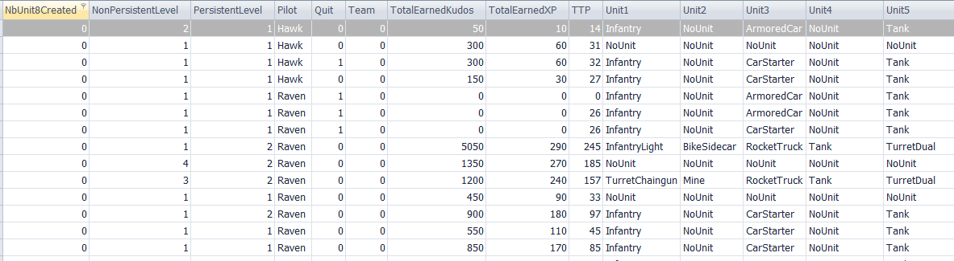
Scope of Data
Monetization data (27 columns, 6742683 rows)
In-game behavior data (53 columns, 49203678 rows)

Slide 4
Scope of the Data
level 3 or up (77% of all players).
Players who stops playing a week later are considered Leavers.
We train/test the algorithm on old gen data, and make predictions on the new gen data.

Slide 5
Algorithmic Parameter Selection
80 potential parameters.
Do all influence the outcome of the algorithm?
Use non-relevant parameters will overfit the model by creating noise.
1/3 of parameters have been dropped/altered.
This first step needs market intelligence and understanding of players’ psychology.

Slide 6
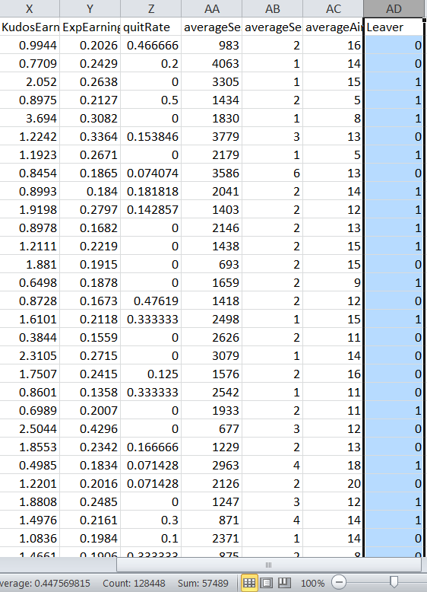
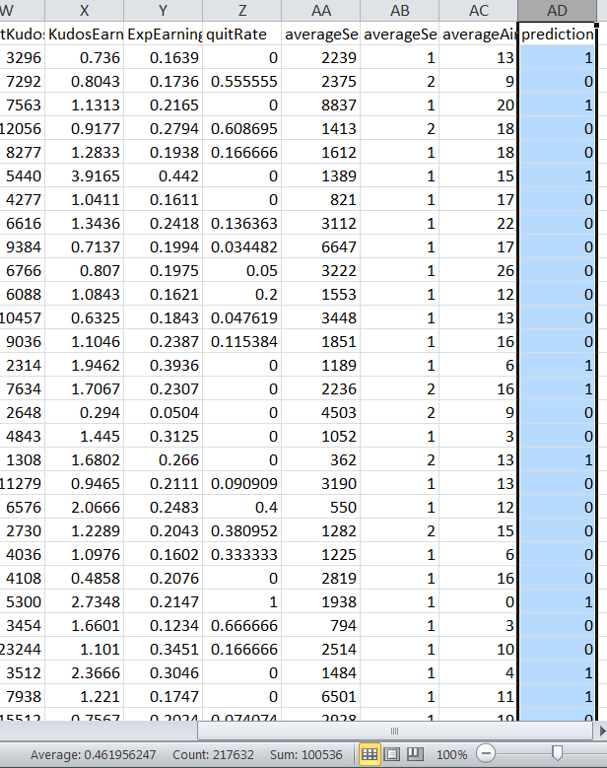
Model Validation
44.8% leavers on old gen, 46.1% predicted to be on new gen, results are consistent.
F-score = 0.64 (industry benchmark = [0.5,0.7].) -> above average.
Old
gen
New gen

Slide 7
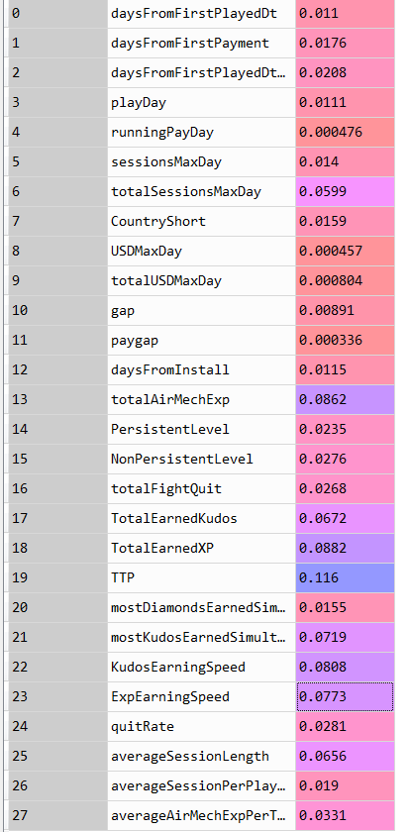
Results
Metrics used Weights on outcome
Total Time Played is the most important metric.
As a player plays less, he/she is more likely to leave soon(no surprise there).
TTP has the most influence

Slide 8
Results
Metrics used Weights on outcome
Average Session Length and Total Sessions are decent indicators of players interest, (confirmed expectations).
Drops in those metrics show interest loss, providing opportunity to re-engage player before losing her.
Sessions-related decent indicators

Slide 9
Results
Metrics used Weights on outcome
Kudos and Exp earning speed are very strong interest indicators.
Tricky : it doesn’t speak of design state, but of players’ behavior.
Player plays faster = faster Kudos/Ex gain = interests to the game. Slowing down the rhythm means they are no longer hooked. How can we change that?
3rd and 4th important indicators are speed-related

Slide 10
Results
Metrics used Weights on outcome
mostKudosEarnedSimultaneously is a surprisingly key factor.
Insight: Anchoring and Optimism Bias at play (“casino symptom”). higher reward ceilings may increase retention.
How to utilize?: -> create a crazy Wednesday with random high reward?
5th Element

Slide 11
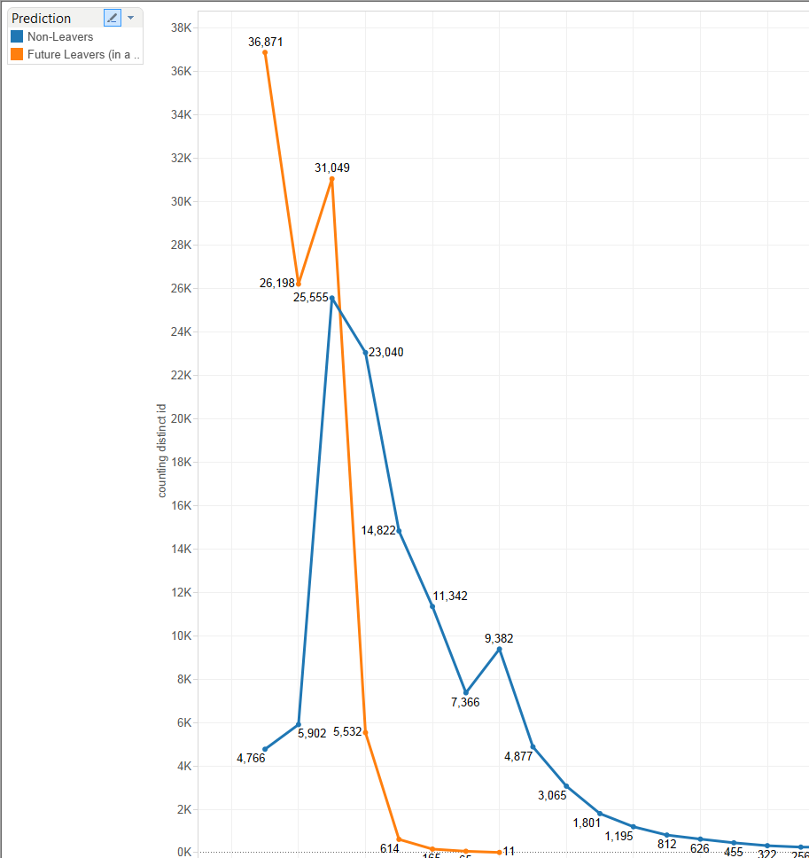
New achievement?
Pic on level 3 (model bias) and 5 (has real value) for future leavers.
Need new achievement for better retention rate.
The level 5 is a cap, need to find a way to make players reach 6.

Slide 12
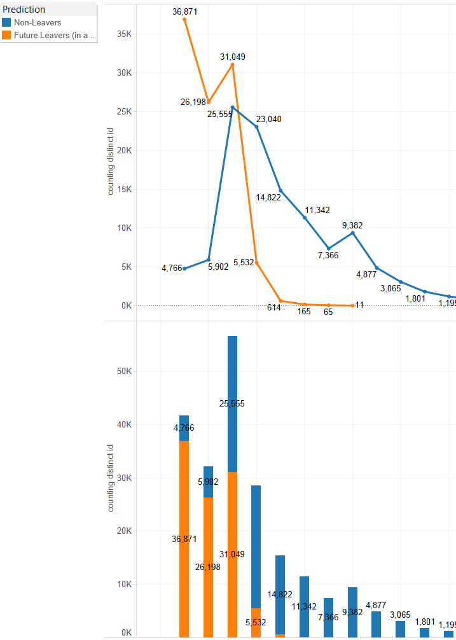
Level distribution
Among predicted leavers: 93.6% have less than level 5.
One more level at level 5: increase from 45.1% to 80.6% likelihood to keep playing.

Slide 13
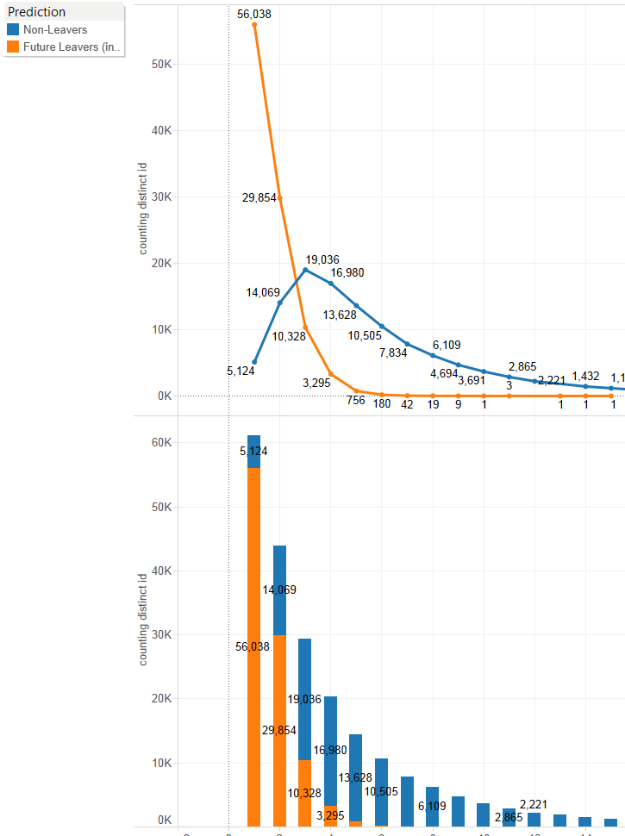
One more session?
Leavers curve is steeper than standard curve.
95.7% of leavers play less than 3 sessions (roughly 1 every 5 days).
One more session at 3 session: increase from 64.8% to 83.7% likelihood to keep playing.

Slide 14
What did we really do:
Start the process with “predicting whether a player leaves” in mind.
Refine algorithm via metrics selection and model optimization.
Corroborate commonly accepted key metrics (TTP)
Find unexpected key metrics and understand why.
3 ways of using the outcome:
Predict player’s likelihood to quit and expected value lost.
Use relevant metrics (expected or unexpected), to track players’ interests raise red flag if need be.
Make design/marketing strategy tweaks accordingly to improve game’s attractiveness.

Slide 15
Philosophy of Data Science
Data Science is not:
Creating the perfect algorithm.
Using all available data to predict an outcome.
Data Science is:
Understanding data better.
Finding and creating relevant metrics.
Thus analyze/understand/predict players’ behavior and make deterministic measures.
all this by improving algorithm’s efficiency.

Slide 16
Conclusion
Predictive analytics != Forecasts.
Improving Machine Learning algorithm is not the end: it is means to finding patterns in players’ behavior that we can’t otherwise.
Objective: Understand players’ behavior, find relevant metrics, thus enable smarter decisions.

Slide 17
Conclusion
Data Analytics in video games:
Yes, it is all about Retention.
(By understanding players’ behaviors better)

